Slide 1
Think of a characteristic that you share with a family member.
Think of a characteristic that you have that none of your family members share.
Notes:
Instructional Approach(s): With an elbow partner, use 1-2 minutes to have students to discuss this information with each other. While it will not be possible for all pairs to share with the class, choose one or two pairs to share their findings with the whole group.

Slide 2
Complete the Genes, Chromosomes, and Heredity Notes during the lesson
Notes:
Instructional Approach(s): The teacher should give each student a copy of the Genes, Chromosomes, and Heredity Notes [linked on the resource page] to record important information during the lesson.

Slide 3
Based on our opening activity, we know that we have characteristics of our parents, yet we are unique individuals. Why is this?
The answer is in the understanding of Heredity.
Notes:
Instructional Approach(s): Transition slide

Slide 4
Heredity is the passing of traits from parents to offspring.
Genetics is the study of heredity.
Notes:
Instructional Approach(s): The teacher should present the information on the slide while the students fill in the answers to #1 and #2 on their notes sheet.

Slide 5
Essential Question: How are genes, chromosomes, and heredity “related” to one another?
Standards:
S7L3a. Explain the role of genes and chromosomes in the process of inheriting a specific trait.
Notes:
Instructional Approach(s): The teacher should review the essential question and the standards that align to the essential question

Slide 6
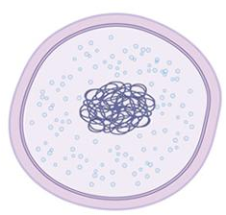
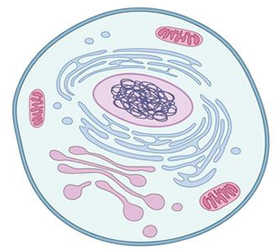
What’s the difference between these two cells?
Prokaryote
Eukaryote
Genetic Material
Genetic Material
Notes:
Instructional Approach(s): Ask students to identify the difference(s) they see, making note of the true difference being the genetic material being contained in a true nucleus in a eukaryote, and not in a true nucleus for a prokaryote.

Slide 7
What’s the purpose of the genetic material?
Prokaryote
Eukaryote
Genetic Material
Genetic Material
Notes:
Instructional Approach(s): The teacher should pose the question to the class and either ask for volunteer responses or call on specific students to answer the question.

Slide 8
So far, we have discussed genetic material in the nucleus of a cell that makes you unique. Now, we can give the genetic material a name…
Genetic Material
DNA
Notes:
Instructional Approach(s): The teacher should present the information on the slide while the students fill in the information for number 3 on their notes worksheet.

Slide 9
DNA stands for…
DeoxyriboNucleic Acid
Genetic Material: DNA
Notes:
Instructional Approach(s): The teacher should present the information on the slide while the students fill in the information for number 3 on their notes worksheet.

Slide 10
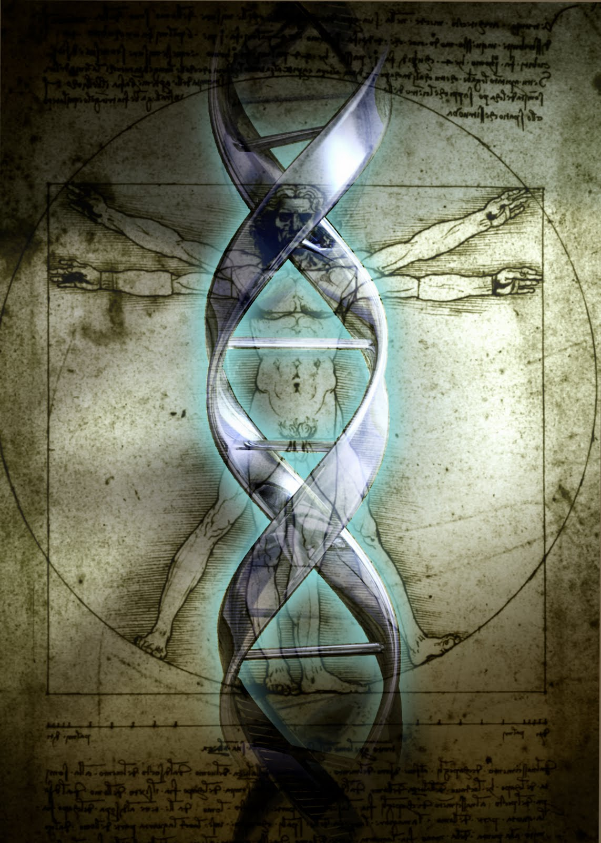
DNA is often referred to as a blueprint because it contains the instructions needed for an organism to grow, maintain itself, and reproduce.
Notes:
Instructional Approach(s): The teacher should present the information on the slide while the students fill in the information for number 3 on their notes worksheet.

Slide 11
Genetic material (DNA) makes you an individual with a unique combination of characteristics. These characteristics are also known as Traits.
Genetic Material
Turn to a seat partner and describe a few Traits that make you different from others.
Notes:
Instructional Approach(s): The teacher should present the information on the slide while the students fill in the information on their notes worksheet. Additionally, give partners about 30 seconds to discuss traits that make them different from others.

Slide 12
Inherited Traits
Many of your traits may resemble those your parents have, including your hair color, eye color, and blood type. These characteristics are called inherited traits.
Some traits are acquired, not inherited. Which means the trait is developed during your life.
Some traits are both inherited and acquired. For example, skin color has both an inherited component and an environmental one.
Notes:
Instructional Approach(s): The teacher should present the information on the slide while the students fill in the information on their notes worksheet.

Slide 13
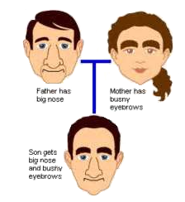
Inherited Traits
Notes:
Instructional Approach(s): The teacher can use the image to illustrate the concept of inherited traits.

Slide 14
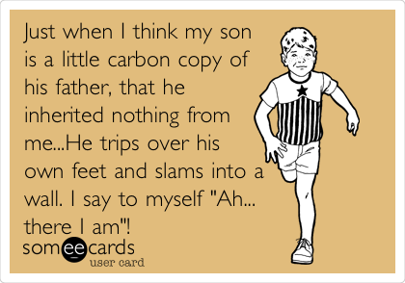
Notes:
Instructional Approach(s): Have a student explain this cartoon (the mother’s trait appears in the son).

Slide 15
Inherited Traits
If a mother works out as a body builder for many years, will her offspring inherit strong muscles? Why or Why Not?
If a father speaks several languages fluently, will his children be able to understand what he is saying in different languages? Why or Why Not?
Notes:
Instructional approach(s): With elbow partners or groups, allow 2-3 minutes for students discuss these two situations. Have one or two groups discuss their answers with the class. (No to both. Both are results of individual efforts, making them acquired.)

Slide 16
Inherited Traits
Turn to a seat partner and share a trait that you inherited and a trait that you may have just acquired.
Notes:
Instructional Approach(s): Have students turn to a partner and discuss the question on the slide. Partners can be determined by the students or the teacher can provide more specific directions such as turn to the person directly in front/behind you or to the right/left of you, etc. It may be necessary to have a group of three if you have an uneven number of students. Do not allow more than 1-2 minutes of discussion time. The teacher should be walking around listening and redirecting discussions as needed. The teacher can briefly discuss student responses.

Slide 17
You inherit traits through sexual reproduction.
During sexual reproduction, a cell containing genetic material (DNA) from the mother and a cell containing genetic material (DNA) from the father combine into a completely new cell, which becomes the offspring.
Notes:
Instructional Approach(s): The teacher should present the information on the slide while the students record the important information on their notes.

Slide 18
Inherited traits are controlled by the structures, materials, and processes you learned about in the previous unit.
Which structures and processes of the cell do you think are responsible for the inheritance of traits?
Notes:
Instructional Approach(s): The teacher should ask the class or call on specific students to recall some of the structures and processes used for the inheritance of traits. If needed, remind students about the nucleus, chromosomes, mitosis, and meiosis.

Slide 19
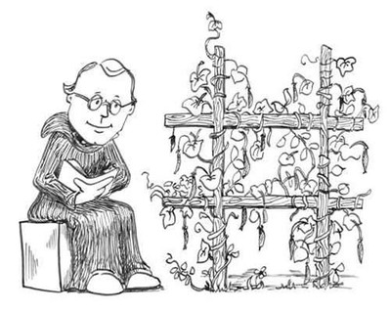
Gregor Mendel discovered that there are patterns to inheritance. He did this by studying pea plants while living at a monastery.
Notes:
Instructional approach(s): Have students fill in notes sheet. ***Include brief explanation of the experiment, about a short pea plant as an offspring of two tall pea plants***

Slide 20
Through Mendel’s discoveries, we found out that inherited traits (characteristics) are determined by genes.
Notes:
Instructional Approach(s): The teacher should present the information on the slide while the students fill in #8 on their notes sheet.

Slide 21
Overview of Mendel’s Experiment
https://www.youtube.com/watch?v=Mehz7tCxjSE

Slide 22
Genes, Chromosomes, Heredity, and DNA, what’s the difference?
Notes:
Transition slide

Slide 23
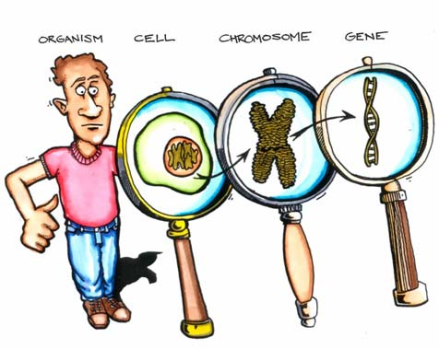
Let’s Look Deeper…
Notes:
Instructional Approach(s): Ask students – by looking at the diagram, where is each one of the items in the magnifying glass located? (Chromosomes in the nucleus of the cell, genes on chromosomes)

Slide 24
A Eukaryotic cell has a Nucleus that contains genetic material.
A Chromosome is the structure that holds the genetic material (DNA).
DNA is the genetic material that provides instructions for all the body’s functions.
A Gene is a section of DNA that provides instructions for specific traits.
Notes:
Instructional Approach(s): The teacher should present the animated slide while the students record the information on their notes. Some actions require a click while other actions fade out automatically. If an action doesn’t occur after 2 seconds, click the mouse for the next action. Have students label the diagram on their notes sheet.

Slide 25
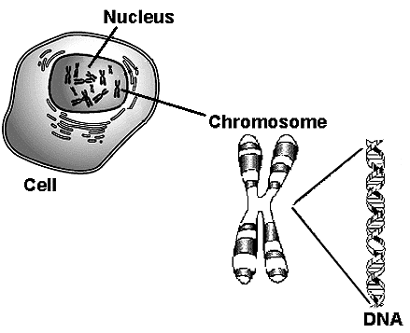

Slide 26
Another Comparison…
Eukaryotic Cell
Nucleus
Chromosome
DNA
Gene
Notes:
Instructional Approach(s): Present information on slide. Discuss levels of organization of genetic material.

Slide 27
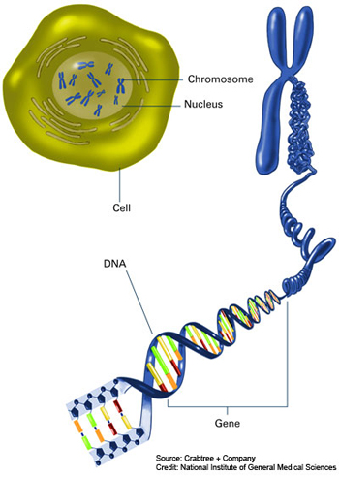
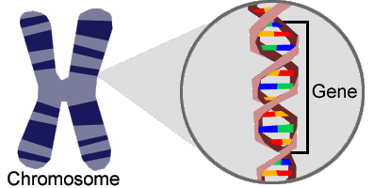
Genes, Chromosomes and DNA
http://learn.genetics.utah.edu/content/chromosomes/intro/
Notes:
Instructional Approach(s): View video clip.

Slide 28
Genes
Genes
Chromosomes
Each set of Genes codes for a different trait
Notes:
Instructional Approach(s): The teacher should present information on slide.

Slide 29
Animations
http://www.yourgenome.org/landing_dgg.shtml
http://learn.genetics.utah.edu/content/molecules/gene/
Notes:
Instructional Approach(s): The teacher should choose one of the video clips to show.

Slide 30
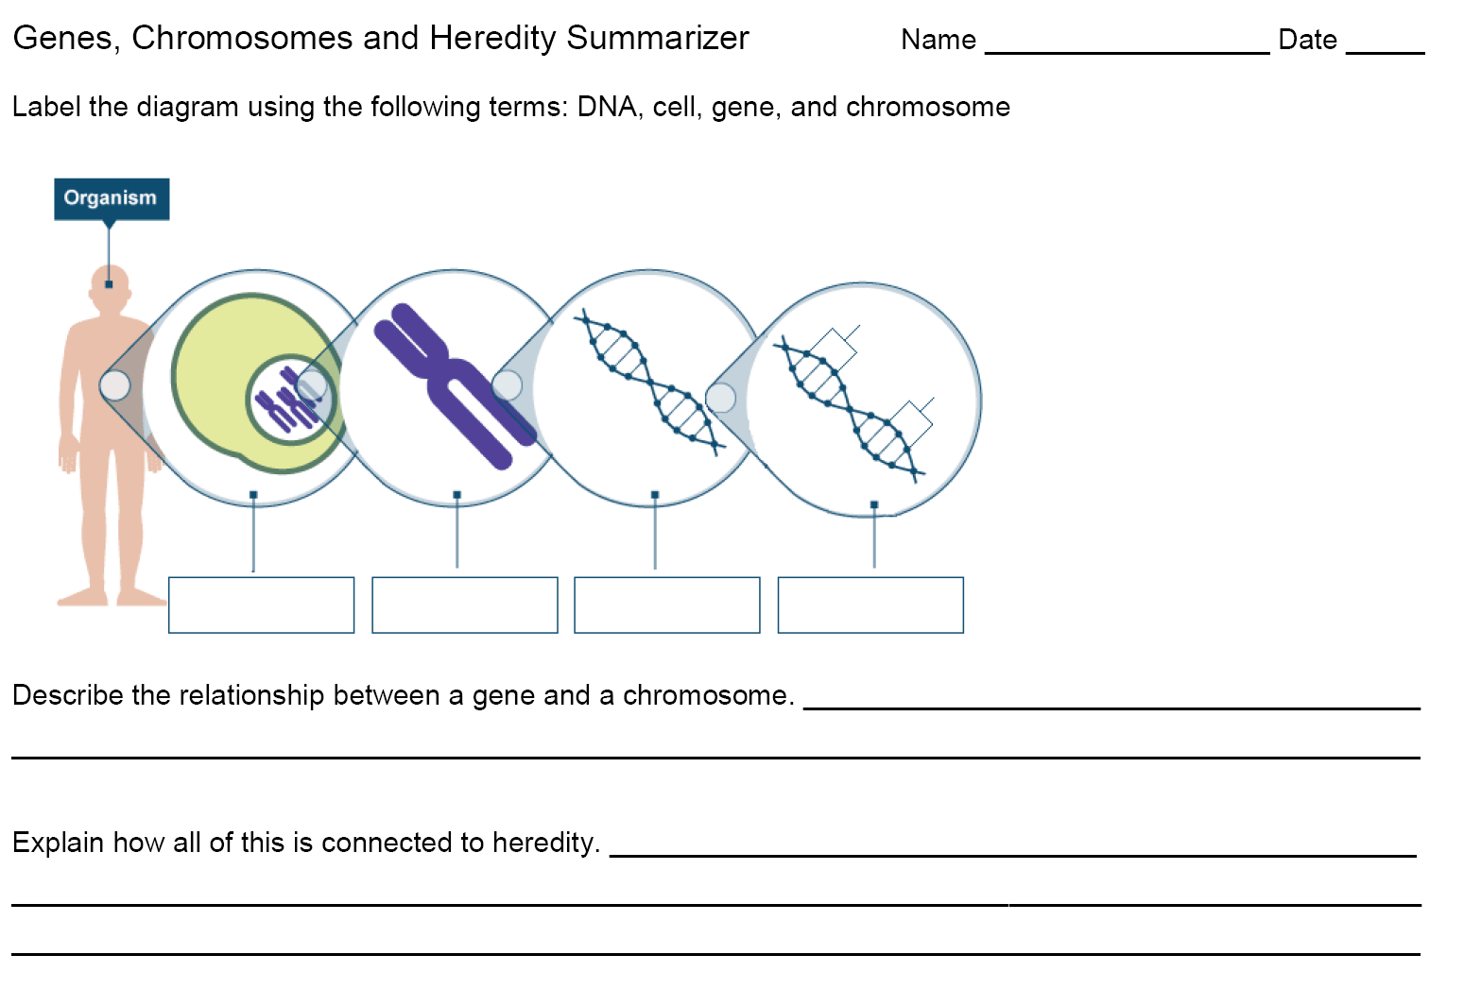
Summarizing Strategy:
Notes:
Instructional Approach(s): Each student should complete the summarizer. The teacher should use the summarizer to determine the level of student mastery and if differentiation is needed.

