Slide 1


Activating Strategy: How did ancient people build massive structures such as the pyramids in Egypt and Stonehenge?
If we did not have the large machines that we have today for building, would we still be able to make these large structures? Why?
Notes:
Instructional Approach(s): The teacher should use the slide to activate students prior knowledge. The teacher can pose the question to the class, individual students, or let the students pair up to answer the questions. The teacher should not spend more than 2-3 minutes on the slide.

Slide 2

Essential Question:
How do simple machines make life easier for us?
Standard:
S8P3c. Demonstrate the effect of simple machines (lever, inclined plane, pulley, wedge, screw, and wheel and axle) on work.
Notes:
Instructional Approach(s): The teacher should introduce the essential question and the standard that aligns to the essential question

Slide 3
Use the Simple Machines Notes Sheet during
the lesson.
Be sure to draw illustrations for each concept shown on the notes sheet.
Notes:
Instructional Approach(s): The teacher should give each student the Simple Machines notes sheet to use to record important information throughout the lesson

Slide 4
Work is when an applied force causes an object to move in the direction of the force.
Notes:
Instructional Approach(s): The teacher should present the information on the slide while the students record the important information on their notes

Slide 5
Suppose you try to push a brick wall over. Is this considered work? Why or why not?
Notes:
Instructional Approach(s): The teacher should ask the class or call on students to answer the question. Click the mouse to reveal the answer on the next slide.

Slide 6
No. Work is done only when an object moves in the same direction of the force that is being applied.
With your seat partner, list two examples of work and two examples of NO work.
Notes:
Instructional Approach(s): Think, Pair, Share. Partners can be determined by the students or the teacher can provide more specific directions such as turn to the person directly in front/behind you or to the right/left of you, etc. It may be necessary to have a group of three if you have an uneven number of students. Do not allow more than 30 seconds to 1 minute of discussion time. The teacher should be walking around listening and redirecting discussions as needed. The teacher can briefly discuss student responses.

Slide 7
http://www.classzone.com/books/ml_science_share/vis_sim/mfm05_pg113_work/mfm05_pg113_work.html
What did you notice
in the simulation?
Notes:
Instructional Approach(s): The teacher should present the link and ask the class or call on students to answer the question.

Slide 8
Work = Force x distance
W = F x d
Notes:
Instructional Approach(s): The teacher should present the information on the slide while the students record the important information on their notes

Slide 9
A machine is a device that makes work easier by changing the size or direction of a force.
Look at the list below and identify which are considered machines:
Can opener
Doorknob
Brake
Knife
Notes:
Instructional Approach(s): The teacher should present the information on the slide while the students record the important information on their notes. The teacher should ask the class or call on students to identify the machines. Answer: All are simple machines.

Slide 10
Machines
There are simple machines and complex machines
Complex machines have 2 or more simple machines
There are six (6) types of simple machines: inclined plane, wedge, screw, lever, pulley, and wheel and axle
Notes:
Instructional Approach(s): The teacher should present the information on the slide while the students record the important information on their notes

Slide 11
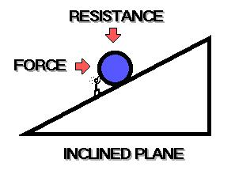
Inclined Plane
Notes:
Instructional Approach(s): The teacher should present the information on the slide

Slide 12
Inclined Plane
Straight, slanted surface
Makes work easier because it is easier to move something to a higher or lower place
Notes:
Instructional Approach(s): The teacher should present the information on the slide while the students record the important information on their notes

Slide 13
With your seat partner, identify at least 3-4 examples of an inclined plane.
Notes:
Instructional Approach(s): Think, Pair, Share. Partners can be determined by the students or the teacher can provide more specific directions such as turn to the person directly in front/behind you or to the right/left of you, etc. It may be necessary to have a group of three if you have an uneven number of students. Do not allow more than 30 seconds to 1 minute of discussion time. The teacher should be walking around listening and redirecting discussions as needed. The teacher can briefly discuss student responses.

Slide 14
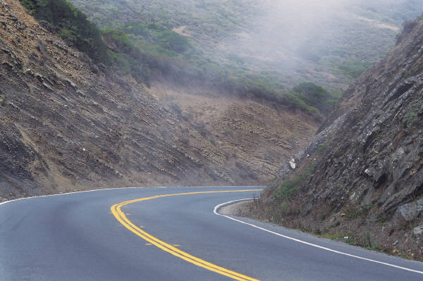
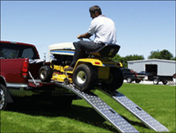
Inclined Planes
Steps
Bathtub
Sloping Roads
Ramp
Notes:
Instructional Approach(s): The teacher should use the images on the slide to illustrate examples of inclined planes while the students record the examples on their graphic organizer.

Slide 15
Inclined Planes
Other examples:
http://www.mikids.com/SMachinesInclinedPlanes.htm
Playground slide, ski jump, animal ramp, wheelchair ramp, etc.
Notes:
Instructional Approach(s): The teacher should use the link on the slide to illustrate examples of inclined planes.

Slide 16
Add these and any other examples of inclined planes to your Simple Machines Graphic Organizer.
Notes:
Instructional Approach(s): The teacher should give each student the Simple Machines graphic organizer sheet to use to record important information throughout the lesson

Slide 17
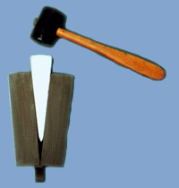
Wedge
Notes:
Instructional Approach(s): The teacher should present the information on the slide

Slide 18
Wedge
Inclined plane that moves
Two inclined planes joined back to back
Wider or thicker at one end than at the other
Makes work easier because when moved, a wedge cuts, splits, or pries apart objects (including air and water)
Notes:
Instructional Approach(s): The teacher should present the information on the slide while the students record the important information on their notes

Slide 19
With your seat partner, identify 3-4 examples of a wedge
Notes:
Instructional Approach(s): Think, Pair, Share. Partners can be determined by the students or the teacher can provide more specific directions such as turn to the person directly in front/behind you or to the right/left of you, etc. It may be necessary to have a group of three if you have an uneven number of students. Do not allow more than 30 seconds to 1 minute of discussion time. The teacher should be walking around listening and redirecting discussions as needed. The teacher can briefly discuss student responses.

Slide 20
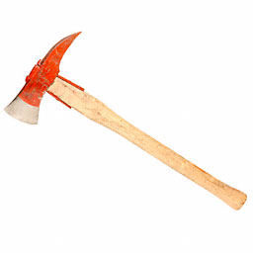
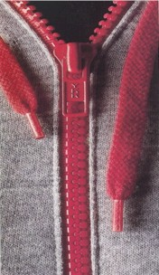
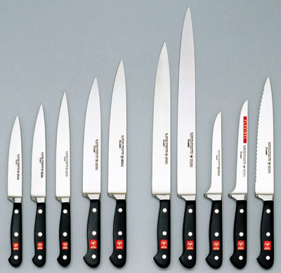

Wedge
Axe
Knife
Zipper
Boat Stern
Bottle Opener
Notes:
Instructional Approach(s): The teacher should use the images on the slide to illustrate examples of wedges.

Slide 21
Wedge
Other examples:
http://www.mikids.com/SMachinesWedges.htm
Door stop, forklift “forks”, teeth
Notes:
Instructional Approach(s): The teacher should use the link on the slide to illustrate examples of wedges.

Slide 22
Add these and any other examples of a wedge to your Simple Machines Graphic Organizer.
Notes:
Instructional Approach(s): The teacher should give each student the Simple Machines graphic organizer sheet to use to record important information throughout the lesson

Slide 23
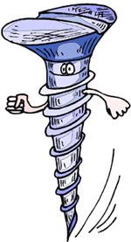
Screw
Notes:
Instructional Approach(s): The teacher should present the information on the slide

Slide 24
Screw
Inclined plane wrapped around a cylinder with a wedge at the tip
Makes work easier because it applies lots of force with little effort
Makes work easier because it is used to hold things together
Thread
Notes:
Instructional Approach(s): The teacher should present the information on the slide while the students record the important information on their notes.
Now would be a good time to do the screw demonstration activity

Slide 25
Think, Pair, Share
Identify 3-4 examples of screws
Do more threads on a screw make work easier or harder? Why?
Why might a screw be called a complex machine?
Notes:
Instructional Approach(s): Think, Pair, Share. Partners can be determined by the students or the teacher can provide more specific directions such as turn to the person directly in front/behind you or to the right/left of you, etc. It may be necessary to have a group of three if you have an uneven number of students. Do not allow more than 30 seconds to 1 minute of discussion time. The teacher should be walking around listening and redirecting discussions as needed. The teacher can briefly discuss student responses.

Slide 26
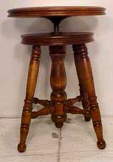
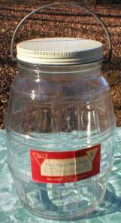
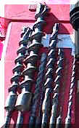
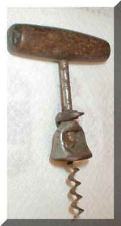
Screws
Swivel stool
Jar lid
Drill bits
Cork screw
Notes:
Instructional Approach(s): The teacher should use the images on the slide to illustrate examples of screws.

Slide 27
Screw
More threads on a screw make it easier to turn, but it takes longer
A screw might be called a complex machine because it has both an inclined plane and a wedge at its tip
Notes:
Instructional Approach(s): The teacher should present the information on the slide while the students record the important information on their notes

Slide 28
Add these and any other examples of a screw to your Simple Machines Graphic Organizer.
Notes:
Instructional Approach(s): The teacher should give each student the Simple Machines graphic organizer sheet to use to record important information throughout the lesson

Slide 29
Lever
Notes:
Instructional Approach(s): The teacher should present the information on the slide

Slide 30
Lever
Made up of a bar that pivots at a fixed point called a fulcrum
Force applied to a lever is called the effort
Object moved is the load
Three classes of levers
Notes:
Instructional Approach(s): The teacher should present the information on the slide while the students record the important information on their notes

Slide 31
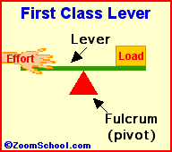
Levers-First Class
In a first class lever the fulcrum is in the middle and the load and effort is on either side
Notes:
Instructional Approach(s): The teacher should present the information on the slide while the students record the important information on their notes

Slide 32
With your seat partner, list 3-4 examples of a First Class Lever.
Notes:
Instructional Approach(s): Think, Pair, Share. Partners can be determined by the students or the teacher can provide more specific directions such as turn to the person directly in front/behind you or to the right/left of you, etc. It may be necessary to have a group of three if you have an uneven number of students. Do not allow more than 30 seconds to 1 minute of discussion time. The teacher should be walking around listening and redirecting discussions as needed. The teacher can briefly discuss student responses.

Slide 33
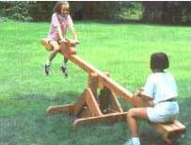
Levers – First Class
Seesaw
Shovel
Hammer’s claws
Scissors
Notes:
Instructional Approach(s): The teacher should use the images on the slide to illustrate examples of levers.

Slide 34
Add these and any other examples of a first class lever to your Simple Machines Graphic Organizer.
Notes:
Instructional Approach(s): The teacher should give each student the Simple Machines graphic organizer sheet to use to record important information throughout the lesson

Slide 35
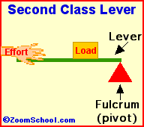
Levers-Second Class
In a second class lever the fulcrum is at the end, with the load in the middle
Notes:
Instructional Approach(s): The teacher should present the information on the slide while the students record the important information on their notes

Slide 36
Levers – Second Class
Wheelbarrow
Stapler
Nut cracker
Notes:
Instructional Approach(s): The teacher should use the images on the slide to illustrate examples of levers.

Slide 37
Add these and any other examples of a second class lever to your Simple Machines Graphic Organizer.
Notes:
Instructional Approach(s): The teacher should give each student the Simple Machines graphic organizer sheet to use to record important information throughout the lesson

Slide 38
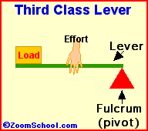
Levers-Third Class
In a third class lever the fulcrum is again at the end, but the effort is in the middle
Notes:
Instructional Approach(s): The teacher should present the information on the slide while the students record the important information on their notes

Slide 39
With your seat partner, list 3-4 examples of a Second Class and Third Class Lever.
Notes:
Instructional Approach(s): Think, Pair, Share. Partners can be determined by the students or the teacher can provide more specific directions such as turn to the person directly in front/behind you or to the right/left of you, etc. It may be necessary to have a group of three if you have an uneven number of students. Do not allow more than 30 seconds to 1 minute of discussion time. The teacher should be walking around listening and redirecting discussions as needed. The teacher can briefly discuss student responses.

Slide 40
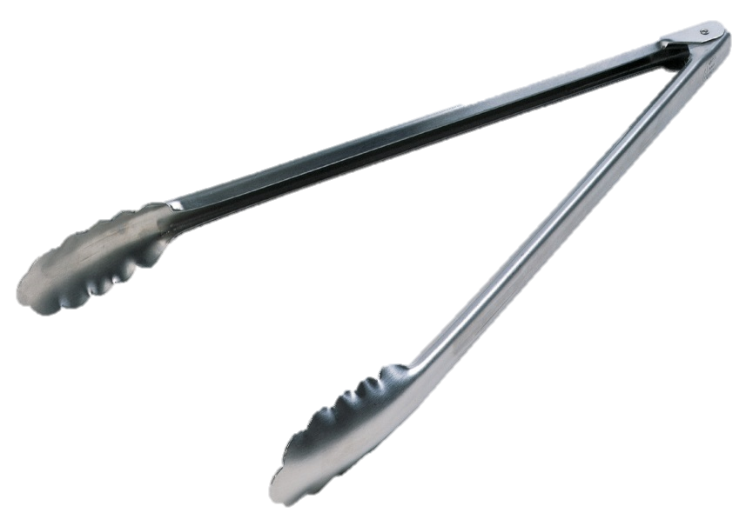

Levers – Third Class
Tongs
Fishing Pole
Broom
Tweezers
Notes:
Instructional Approach(s): The teacher should use the images on the slide to illustrate examples of levers.

Slide 41
Add these and any other examples of a third class lever to your Simple Machines Graphic Organizer.
Notes:
Instructional Approach(s): The teacher should give each student the Simple Machines graphic organizer sheet to use to record important information throughout the lesson

Slide 42
Other examples of levers:
http://www.mikids.com/SMachinesLevers.htm
Critical Thinking: What is the relationship between the location of the fulcrum in a lever and effort?
The closer the fulcrum is to the load, the less effort you will need
Notes:
Instructional Approach(s): The teacher should use the link on the slide to illustrate examples of levers and initiate critical thinking question. The teacher should ask the class or call on students, or allow students to discuss the question with a partner. Briefly discuss student responses with the class. When ready, click the mouse to reveal the answer. Do not spend more than 5 minutes total on the question and discussion time.

Slide 43
Types of Levers
Task Rotation
[see resources]
Notes:
Instructional Approach(s): If needed, the teacher can use the additional activities [linked on the Force & Motion resource page] to review or differentiate.

Slide 44
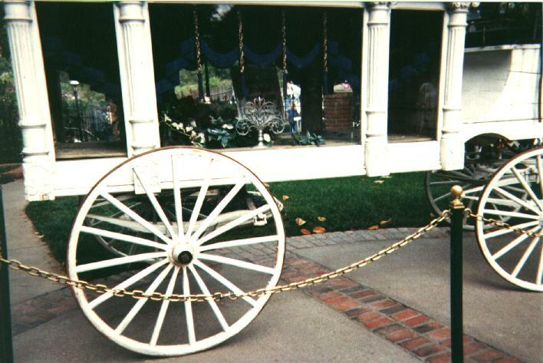
Wheel and Axle
Notes:
Instructional Approach(s): The teacher should present the information on the slide

Slide 45
Wheel and Axle
Consists of two circular objects of different sizes
A wheel is connected to a post (axle)
Wheel is larger than the axle
Makes work easier because it applies more force or lifts a heavy load with less effort
Notes:
Instructional Approach(s): The teacher should present the information on the slide while the students record the important information on their notes

Slide 46
With your seat partner, list 3-4 examples of a Wheel and Axle.
Notes:
Instructional Approach(s): Think, Pair, Share. Partners can be determined by the students or the teacher can provide more specific directions such as turn to the person directly in front/behind you or to the right/left of you, etc. It may be necessary to have a group of three if you have an uneven number of students. Do not allow more than 30 seconds to 1 minute of discussion time. The teacher should be walking around listening and redirecting discussions as needed. The teacher can briefly discuss student responses.

Slide 47
Wheel and Axle
Door knob
Wrench and bolt
Well
crank
Steering
wheel
Notes:
Instructional Approach(s): The teacher should use the images on the slide to illustrate examples of wheel and axles.

Slide 48
Add these and any other examples of a Wheel and Axle to your Simple Machines Graphic Organizer.
Notes:
Instructional Approach(s): The teacher should give each student the Simple Machines graphic organizer sheet to use to record important information throughout the lesson

Slide 49
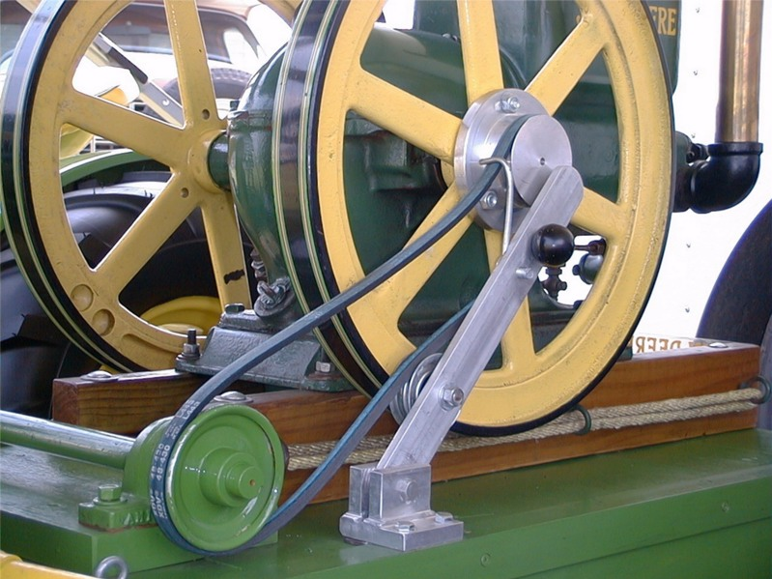
Pulley
Notes:
Instructional Approach(s): The teacher should present the information on the slide

Slide 50
Pulley
Wheel and axle with a groove around the outside
A pulley needs a rope, chain or belt around the groove to make it do work
Pulley systems can consist of one or more fixed pulleys, one or more moveable pulleys, or both fixed and movable pulleys.
Makes work easier by changing the direction of the force or multiplying the effort used
Notes:
Instructional Approach(s): The teacher should present the information on the slide while the students record the important information on their notes

Slide 51
With your seat partner, list 3-4 examples of a Pulley.
Notes:
Instructional Approach(s): Think, Pair, Share. Partners can be determined by the students or the teacher can provide more specific directions such as turn to the person directly in front/behind you or to the right/left of you, etc. It may be necessary to have a group of three if you have an uneven number of students. Do not allow more than 30 seconds to 1 minute of discussion time. The teacher should be walking around listening and redirecting discussions as needed. The teacher can briefly discuss student responses.

Slide 52

Pulley
Flag Pole
Ski Lift
Clothesline
Notes:
Instructional Approach(s): The teacher should use the images on the slide to illustrate examples of pulleys.

Slide 53
Add these and any other examples of a Pulley to your Simple Machines Graphic Organizer.
Notes:
Instructional Approach(s): The teacher should give each student the Simple Machines graphic organizer sheet to use to record important information throughout the lesson

Slide 54
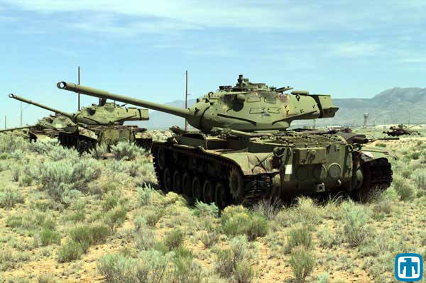
Complex Machines
Simple Machines can be put together in different ways to make complex machines
Notes:
Instructional Approach(s): The teacher should present the information on the slide while the students record the important information on their notes

Slide 55
Optional Activities
Simple Machine Scavenger Hunt
Simple Machines Category Cards
What Would You Use? Handout
Rube Goldberg Projects
Pinball Wizard Simple Machines
Target Practice Simple Machine
Notes:
Instructional Approach(s): If needed, the teacher can use the additional activities [linked on the Force & Motion resource page] to review or labs/projects.

Slide 56
Summarizing Strategy
http://www.youtube.com/watch?v=8H41zbqrwVo
Notes:
Instructional Approach(s): Each student should complete the summarizer. The teacher should use the summarizer as a formative assessment tool to determine the level of student mastery and if differentiation is needed.

